Slide 1

Warby Parker Project
Learn SQL from Scratch
Sunwoo Chae
11/12/18

Slide 2
Table of Contents
Get familiar with Warby Parker
What is the Quiz Funnel
A/B Testing with Home Try-On Funnel

Slide 3
1. Warby Parker

Slide 4
What is Warby Parker?
Warby Parker is an American online retail store of prescription glasses and sunglasses. The company revolutionized the idea of fashionable yet affordable glasses for everyone
The key point for Warby Parker is that they have a home try on option for their glasses online which allows customers to see and try on the frames before they commit.

Slide 5
2. Determining Data

Slide 6
2.1 Quiz Funnel
What columns does the quiz table have?
Question
User_ID
Response
Question | User_ID | Response
1. What are you looking for? | 005e7f99-d48c-4fce-b605-10506c85aaf7 | Women's Styles
2. What's your fit? | 005e7f99-d48c-4fce-b605-10506c85aaf7 | Medium
3. Which shapes do you like? | 00a556ed-f13e-4c67-8704-27e3573684cd | Round
4. Which colors do you like? | 00a556ed-f13e-4c67-8704-27e3573684cd | Two-Tone

Slide 7
2.2 Quiz Funnel
What is the number of responses for each question?
-- You can put your query here
select question,
count (distinct user_id)
from survey
group by 1;
question | count (distinct user_id)
1. What are you looking for? | 500
2. What's your fit? | 475
3. Which shapes do you like? | 380
4. Which colors do you like? | 361
5. When was your last eye exam? | 270

Slide 8
2.3 Quiz Funnel
question | count (distinct user_id) | Percentage
1. What are you looking for? | 500 | 100%
2. What's your fit? | 475 | 95%
3. Which shapes do you like? | 380 | 76%
4. Which colors do you like? | 361 | 72%
5. When was your last eye exam? | 270 | 54%
Which question(s) of the quiz have a lower completion rates?
What do you think is the reason?
5th question has the lowest response rate. The first four questions were based on customer’s preference and style which could be answered right away but the last question asks about the time of their last eye exam which they might not remember exactly resulting in giving up the quiz.

Slide 9
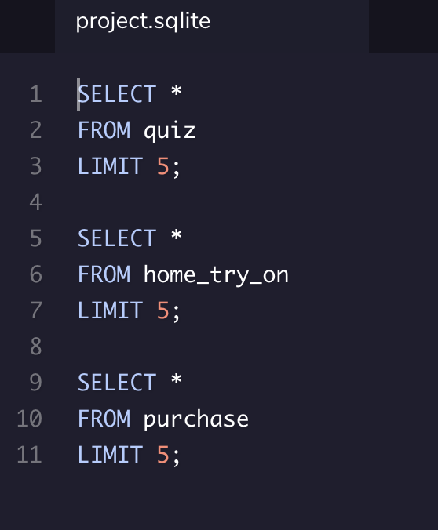
2.4 Comparing Tables
What are the columns of all the tables?
Quiz Table:
Home Try On Table:
Purchase Table:
user_id | style | fit | shape | color
user_id | number_of_pairs | address
user_id | product_id | style | model_name | color

Slide 10
3. A/B Testing on Home Try On Funnel

Slide 11
3.1 Home Try On Funnel
Using the funnel case, the users who had 5 pairs of glasses to try on at home led to more purchases. While 3 pairs are almost evenly split between purchase and no purchase, 5 pair try ons are skewed largely towards purchase..
count(user_id) | is_home_try_on | number_of_pairs | is_purchase
178 | 1 | 3 pairs | 0
201 | 1 | 3 pairs | 1
77 | 1 | 5 pairs | 0
294 | 1 | 5 pairs | 1
250 | 0 | - | 0

Slide 12
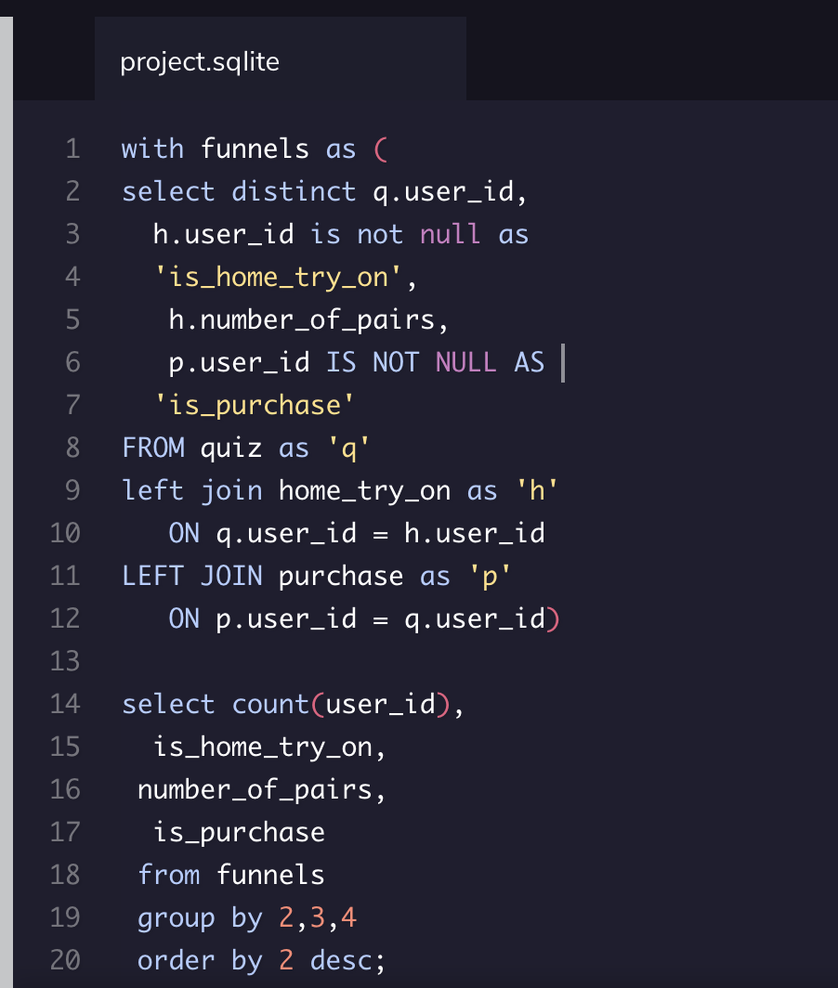
3.2 Home Try On Funnel SQL
Using the funnel sequence, this SQL was able to left join 3 tables and sort out a new one

